Slide 1
Phoenix Boot Process Introduction - xloader
Jacky Zhu 2017-10-20

Slide 2
Outline
Boot Process Overview
HW Power Up
X-loader
U-boot
Kernel boot
Android boot
* Grey part will be introduced later

Slide 3
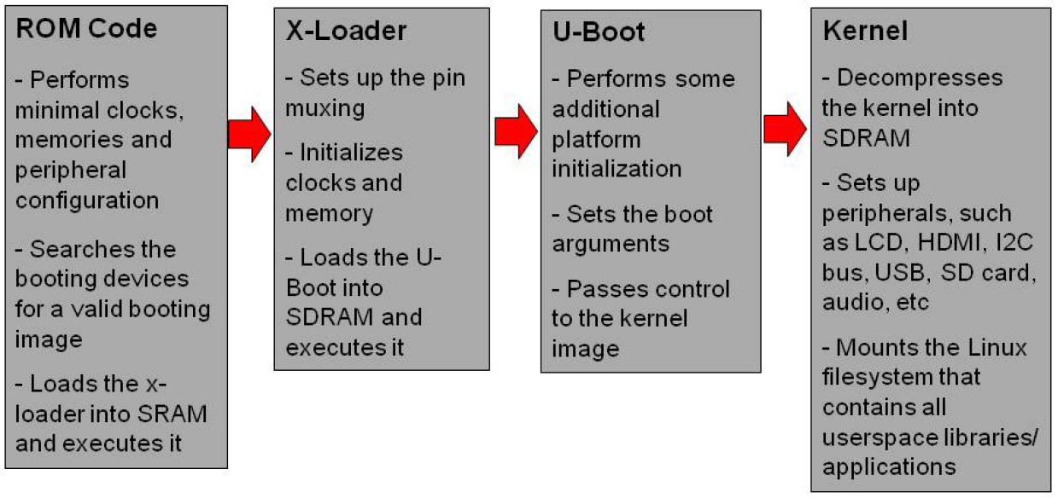
OMAP Boot Process Overview

Slide 4
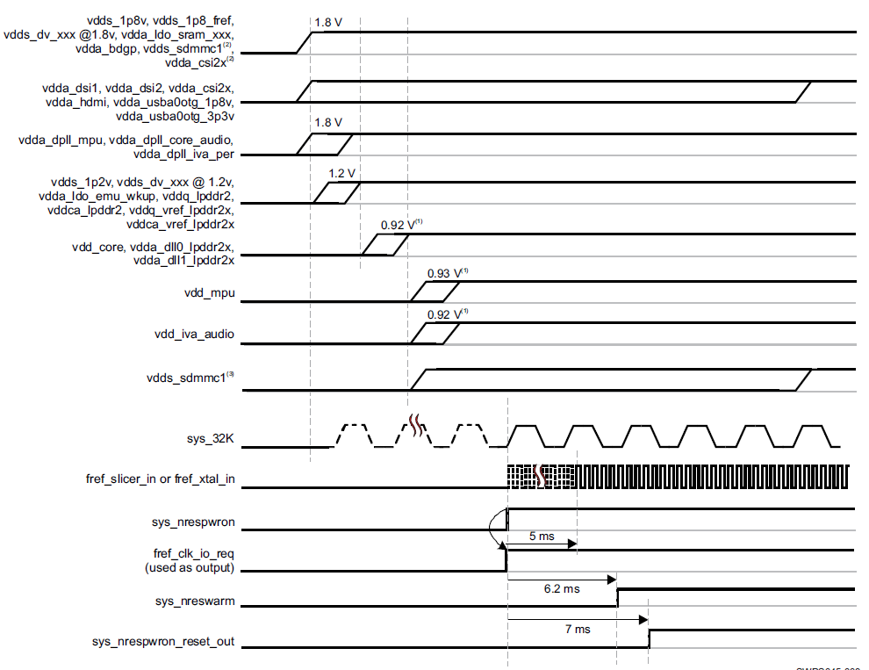
Hardware Power-Up Sequence

Slide 5
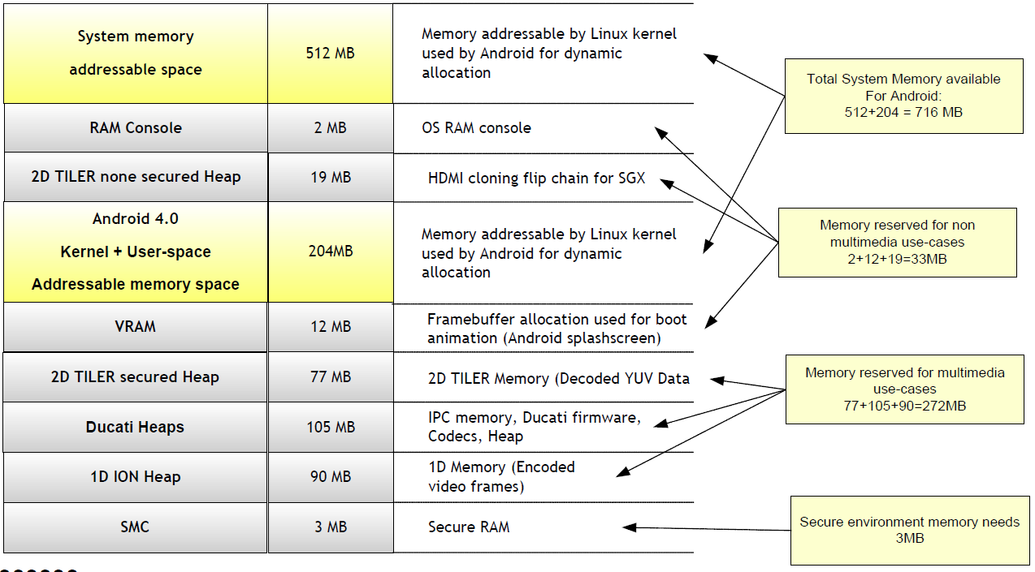
Memory Map
* Based on 1GB Memory

Slide 6
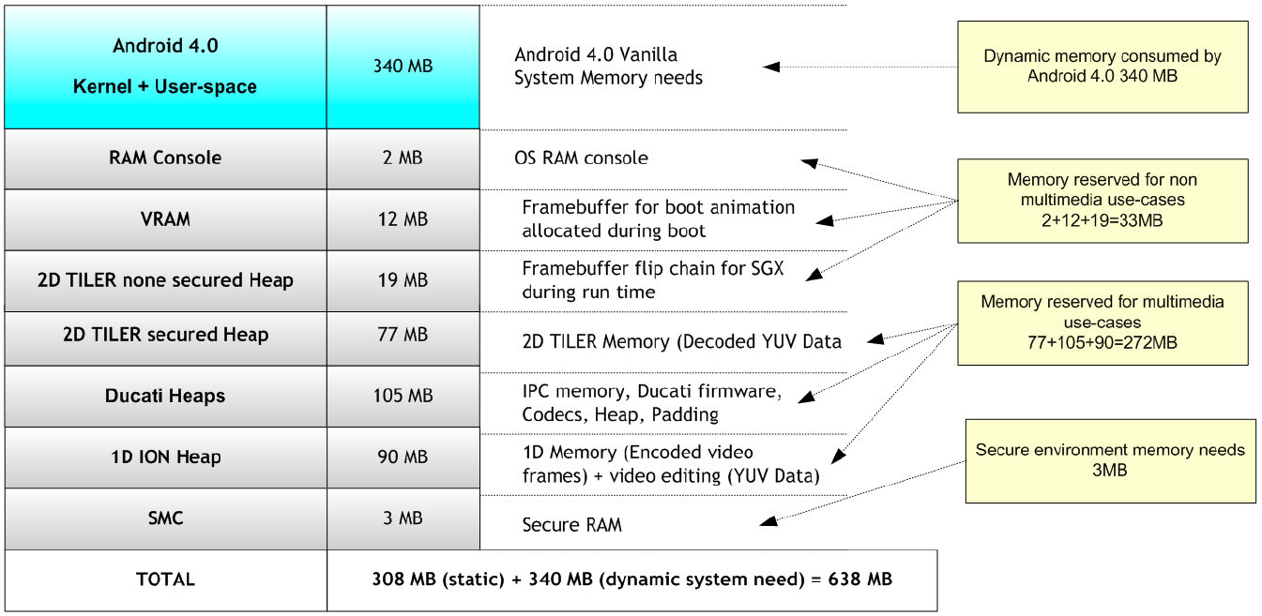
OMAP Android 4 Memory Consumption
* Based on 1GB Memory

Slide 7
X-loader Tasks
Store the boot reason
Setup important registers
Setup memory timing
Early system init of muxing and clocks
PIN setting
I2C clock configuration
vdd_core/vdd_mpu/vdd_iva voltage setting
Init clocks for PRCM
Configure all DPLL's at 100% OPP, enable all clocks
DDR init
High temperature protection
Load and run u-boot

Slide 8
X-loader Main Process
.globl _start
-> reset
-> cpu_init_crit
-> lowlevel_init
-> s_init
-> set_muxconf_regs
-> scale_vcores
-> prcm_init
-> enable_all_clocks
-> ddr_init (__ddr_init)
-> _start_armboot (start_armboot)
-> mmc_read_bootloader (read u-boot and store to 0x80e80000)
-> verify_bootloader_image
-> jump to 0x80e80000 to run u-boot

Slide 9
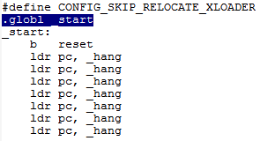
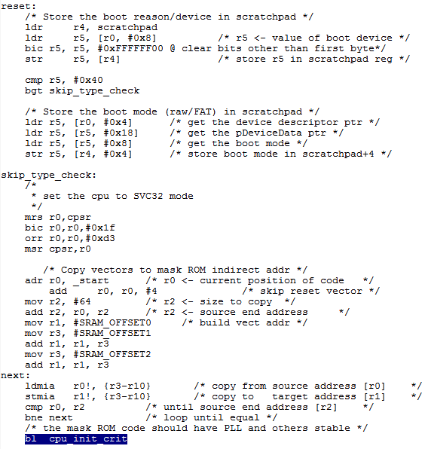
Init steps for X-loader

Slide 10
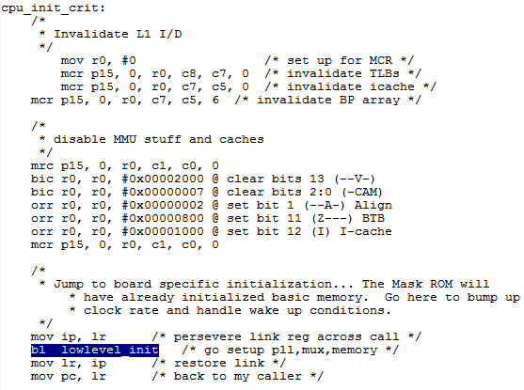
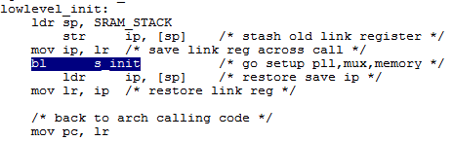
Low Level Init

Slide 11
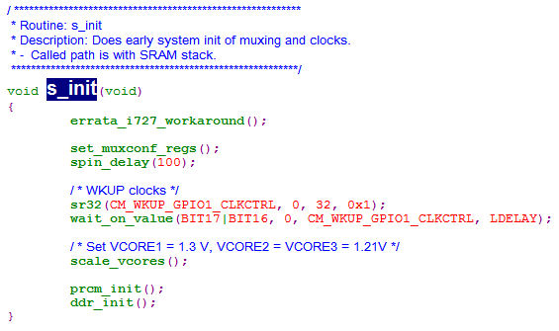
Low Level Init – s_init

Slide 12
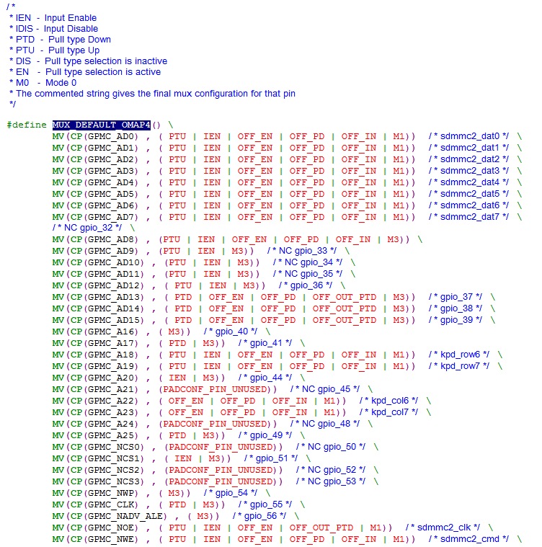
Low Level Init - PIN Setting

Slide 13
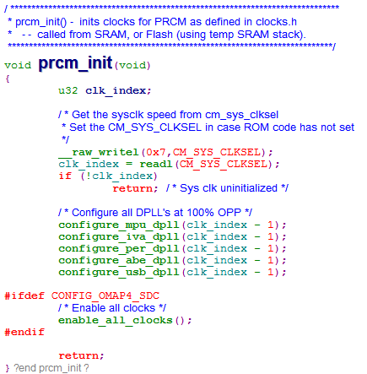
Low Level Init – prcm_init

Slide 14
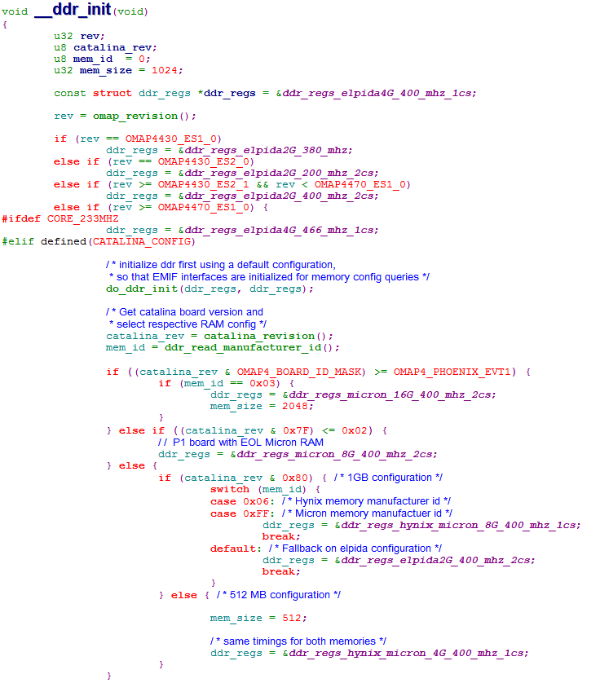
Low Level Init – DDR Init

Slide 15
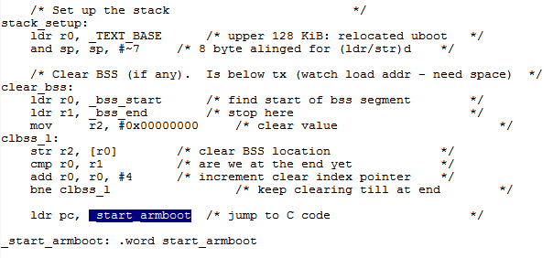
start_armboot

Slide 16
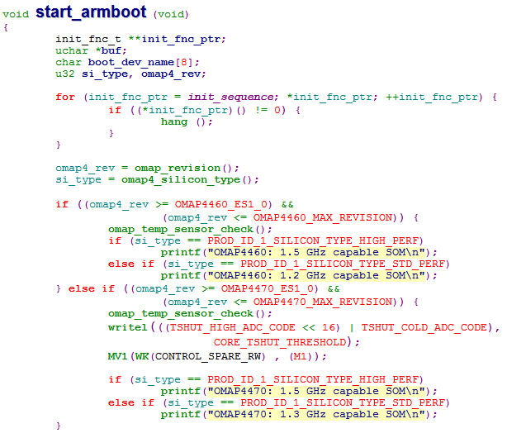
start_armboot

Slide 17
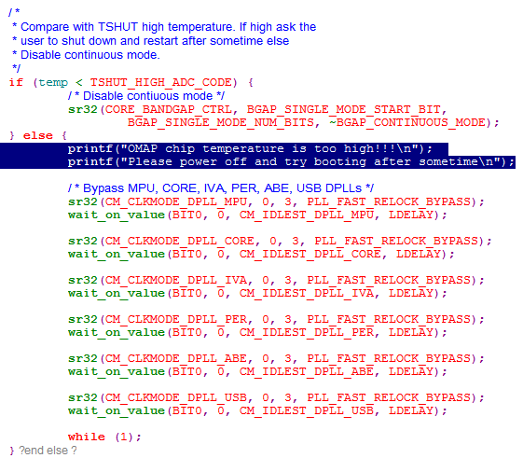
Over Temperature Protection

Slide 18
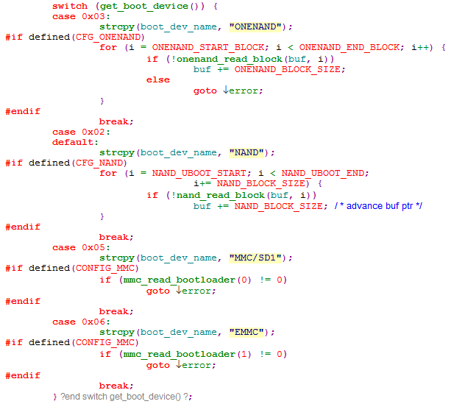

Load and Run u-boot

Slide 19


